Slide 1


Vladimir Ž. Jovanović
Biljana Mišić Ilić
Marta Veličković
University of Niš
IMAGE-SCHEMATIC COMPLEXES
IN POLITICAL DISCOURSE CONCEPTUALIZATIONS:
A CORPUS-BASED CONTRASTIVE STUDY
Figurative Thought and Language 7 Conference
Genoa, Italy, September 20-22nd, 2023

Slide 2
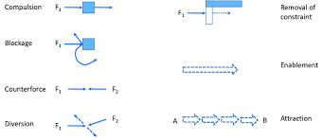
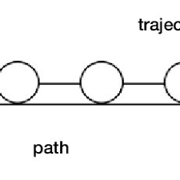
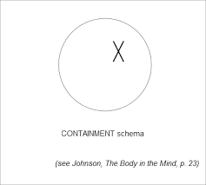
1. Introduction
TOPIC:
Image schemas (Johnson, 1987; Oakley, 2007; Mandler & Canovas, 2014) and their dynamic complexes as elements of conceptual construction and meaning generation in language.
FORCE
PATH
CONTAINMENT

Slide 3
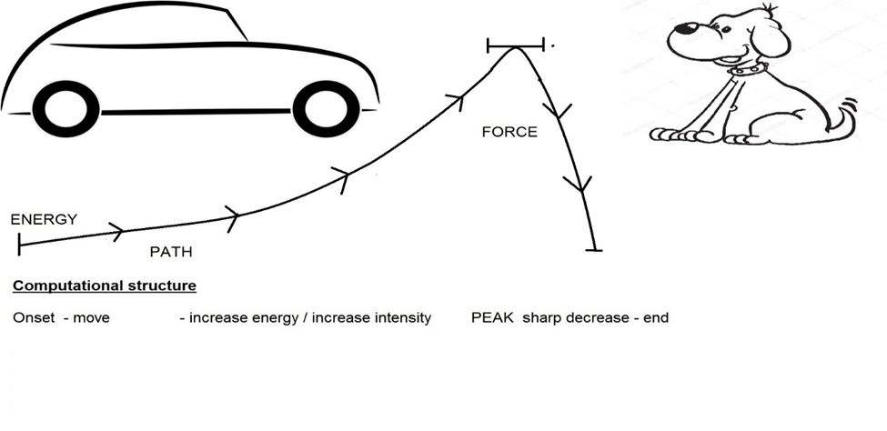
1. Introduction
Part of the SCHEMAS project.
Image schematic complexes: A car sped up and hit a dog in the street.

Slide 4
1. Introduction
The primary interest:
– instantiations based on IS groupings and the schematic interaction with scale,
- their distribution within the figurative and non-figurative language in media coverage.
Targeted IS: PATH, FORCE, LINK, CONTAINMENT and BALANCE
(Clausner & Croft, 1999; Evans & Green, 2006).

Slide 5
1. Introduction
FOCUS: Motion verbs and other related language forms (adverbials, nominalisations).
BASIC ASSUMPTIONS:
  Certain IS complexes, particularly those involving F, P and L appear to be more dominant - the nature of the politico-economic register of both languages,
  IS complexes are featured differently in the conceptualization of non-metaphoric and metaphoric language expressions, and
  The factor of scalarity has a significant role in the formulation of image schematic complexes. =>
How schematicity could be employed to calculate the degree of affectivity and/or bias as a correlative of topic, text authors and/or media.

Slide 6
1. Introduction
OBJECTIVES and HYPOTHESES:
Testing 3 related theses:
  (1) The increase of the number of IS in a complex increases the number of metaphorical conceptualizations in the corpus;
  (2) Their individual intensity increases the affective connotation of the targeted expression; and
  (3) The hypothesized increase may be shown to work in both English and Serbian, resulting in a common core and segments more specific in lingua-cultural terms.

Slide 7
1. Introduction
CORPUS:
2 sub-corpora, totalling around 400,000 words (200,000 each) and over 5,000 annotated units.
Compiled from politico-economic articles sourced from the internet platforms of 8 daily newspapers of different type.
English: The Guardian, The Daily Telegraph, the New York Times, the Washington Times.
Serbian: Politika, Dnevnik, Danas, Blic.

Slide 8
1. Introduction
METHODOLOGY:
Based on the Image schema identification and annotation protocol developed and verified by the SCHEMAS Group 2022 (Figar & Veličković, 2022).
Individual raters (8), manual annotations in texts, interrater agreement of three annotators conducted.
The principles of annotation, the symbols and categories agreed on among 8 annotators
<s>, <ms>, <F>, <P>, <L>, <C>, <B>
Neutral, +, ++,++, -,--,---,

Slide 9
2. Theoretical Background
Conceived of by linguists and psychologists, Cienki (1997), Hedblom, et al. (2015; 2016, 2019), Johnson (1987; 2005; 2007), Lakoff (1987, 1990), Lakoff and Turner (1989), Mandler (1992; 2004; 2012; 2014), Oakley (2007) and others.
Observed as relatively self-sufficient and delineable preconceptual building blocks (Popova, 2005), abstract elements for concept formation in the human mind, such as PATH, LINK, or CONTAINER.

Slide 10
2. Theoretical Background
Said to motivate metaphorical expressions exhibiting some emotional load:
(1) Our relationship is heading nowhere
(2) These two problems go hand in hand
(3) He got completely subsumed by hatred
(Lakoff & Johnson, 1980).

Slide 11
2. Theoretical Background
Our proposition (Antović, Jovanović, Figar 2023) - a possible formal account of such image-schema interaction.
ISs are “enriched” with the higher-order factor of scalarity, where intensities of individual schemas in the group may vary in real time.
As a rule, the more intense the schematic structure, the greater the chance that the resulting interpretation will be emotionally laden, and strongly metaphorical.
(4) a. troops go into Sievierodonetsk <s><P+><F+><C+>
    b. troops invade Sievierodonetsk <s><P+><F++><C++>
    c. troops storm Sievierodonetsk <ms><P++><F+++><C++>

Slide 12
2. Theoretical Background
This approach - entails a system for capturing affective nuances of meaning in cross-language test cases based on the identification and scalarization of interacting image schemas.
SCALE often stands out from the others - a possible reason, it is not really a schema, but rather a higher-order principle specifying the intensity with which other schemas interact.
E.g. the conceptualized FORCE can be very weak, as in a tickle, medium, in pressure, and high, e.g., a crush.

Slide 13
3. Research results
The first empirical research with IS undertaken of its kind.
The actual manifestation of IS in motion verb conceptualizations.
Starting assumption: any conceptualization of moving would entail 2 indispensable ISs
    FORCE - as the agent that creates the motion and
    PATH - any distance covered in the motion in any direction and way.
    Additional research questions:
    Which IS would compose the complex?
    Would there be more elaborate conceptualizations in terms of IS?
    What trends are identical, similar or different in E and S.

Slide 14
3. Research results
(8) Forces defending the besieged port city said their ammunition was running out<ms><F+><P++><L-><C->
R statistical analysis, individual researcher processing (number of schematic complexes and their frequency).
We used t-tests (independent and paired samples) and ANOVAs to ascertain whether statistical differences existed between the two sub-corpora.
(https://www.theguardian.com/world/2022/apr/11/austrian-chancellor-to-tell-putin-he-has-lost-the-war-morally)

Slide 15
3. Research results
Are there any statistically-significant differences in the distribution of schematic complexes when comparing those occurring in non-metaphorical versus those occurring in metaphorical contexts?
 | CORPUS | Mean | N | Std. Deviation | Std. Error Mean
Pair 1 | Unique Non-metaphorical | 123.50 | 8 | 46.263 | 16.357
 | Unique Metaphorical | 263.13 | 8 | 125.785 | 44.472
Pair 2 | Sum of Non-metaphorical complexes | 338.63 | 8 | 135.209 | 47.804
 | Sum of Metaphorical complexes | 947.25 | 8 | 302.674 | 107.011

Slide 16
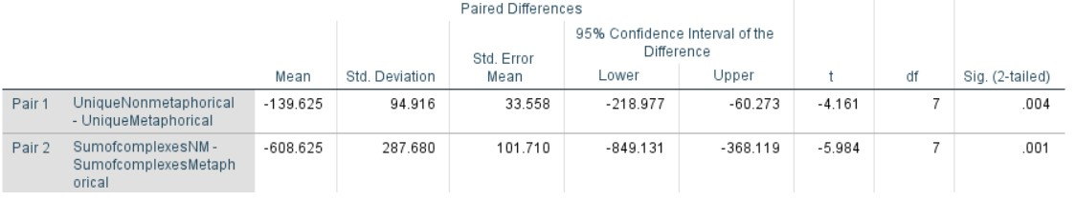
3. Research results
It appears that there is a significant difference in favor of unique metaphorical schema complexes and the total number of metaphorical schema complexes observed.
This suggests that on the level of the overall corpus a statistically significant number of schematic complexes are found in metaphorical contexts.

Slide 17
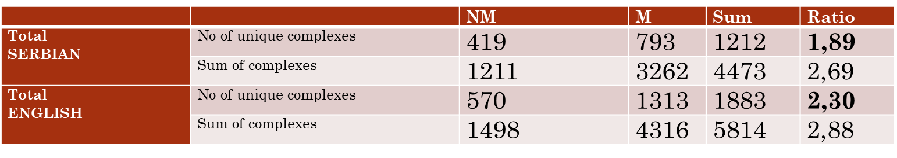
3. Research results
The difference is more prominent in English than in Serbian.

Slide 18
3. Research results
Are there any significant differences in the distribution of schematic complexes across the two languages based on individual schemas?
 | Language | N | Mean | Std. Deviation | Std. Error Mean
@3S | Serbian | 4 | 61.75 | 29.170 | 14.585
 | English | 4 | 103.00 | 46.469 | 23.234
@3MS | Serbian | 4 | 106.25 | 70.296 | 35.148
 | English | 4 | 201.00 | 58.992 | 29.496
@4S | Serbian | 4 | 21.25 | 21.109 | 10.554
 | English | 4 | 44.25 | 52.239 | 26.120
@4MS | Serbian | 4 | 37.50 | 36.419 | 18.209
 | English | 4 | 51.75 | 46.564 | 23.282
@5S | Serbian | 4 | .25 | .500 | .250
 | English | 4 | .25 | .500 | .250
@5MS | Serbian | 4 | .25 | .500 | .250
 | English | 4 | 1.25 | 1.258 | .629

Slide 19
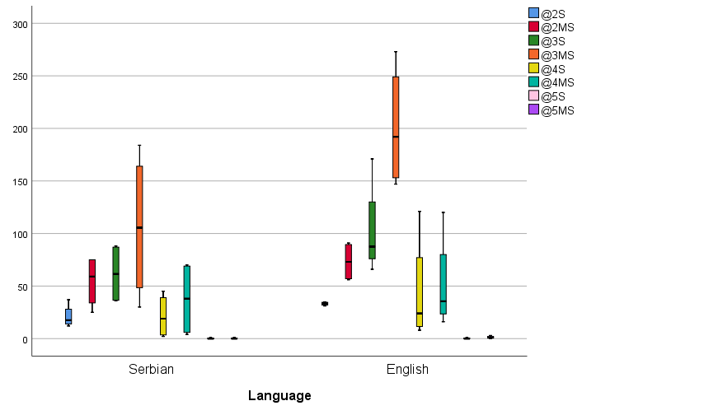
3. Research results
Figure 1: Distribution of schematic complexes across languages

Slide 20
3. Research results
Are there any significant differences in the distribution of schematic complexes across the two languages based on individual schemas?
 | t | df | P-value | Mean Difference | Std. Error Difference | 95 % Lower | 95 % Upper
@3S | -1.504 | 6 | 0.183 | -41.25 | 27.433 | -108.376 | 25.876
@3MS | -2.065 | 6 | 0.084 | -94.75 | 45.885 | -207.026 | 17.526
@4S | -0.816 | 6 | 0.445 | -23 | 28.171 | -91.933 | 45.933
@4MS | -0.482 | 6 | 0.647 | -14.25 | 29.558 | -86.575 | 58.075
@5S | 0 | 6 | 1 | 0 | 0.354 | -0.865 | 0.865
@5MS | -1.477 | 6 | 0.19 | -1 | 0.677 | -2.657 | 0.657

Slide 21
3. Research results
The predominant model, the largest number of annotations - three image schemas in motion conceptualizations, FORCE, PATH + LINK/ CONTAINMENT/BALANCE in both English and Serbian.
FORCE + PATH + LINK
Very elaborate conceptualizations with 5 image schemas involved rarely in both sub-corpora.

Slide 22
3. Research results
Does the distribution of complexes occurring in non-metaphorical versus metaphorical contexts differ based on language?
Serbian |  | Mean | N | Std. Deviation | Std. Error Mean
Pair 1 | UniqueNonmetaphorical | 104.25 | 4 | 59.478 | 29.739
 | UniqueMetaphorical | 198.50 | 4 | 130.257 | 65.129
Pair 2 | SumofcomplexesNM | 302.75 | 4 | 134.886 | 67.443
 | SumofcomplexesMetaphorical | 815.50 | 4 | 283.513 | 141.757
English |  | Mean | N | Std. Deviation | Std. Error Mean
Pair 1 | UniqueNonmetaphorical | 142.75 | 4 | 21.639 | 10.820
 | UniqueMetaphorical | 327.75 | 4 | 93.881 | 46.940
Pair 2 | SumofcomplexesNM | 374.50 | 4 | 145.018 | 72.509
 | SumofcomplexesMetaphorical | 1079.00 | 4 | 295.115 | 147.557

Slide 23
3. Research results
Does the distribution of complexes occurring in non-metaphorical versus metaphorical contexts differ based on language?
 | T-test Serbian | Mean | SD | Std. Error Mean | 95% Lower | 95% Upper | t | df | P value
Pair 1 | UniqueNonmetaphorical - UniqueMetaphorical | -94.250 | 79.529 | 39.765 | -220.799 | 32.299 | -2.370 | 3 | .098
Pair 2 | SumofcomplexesNM - SumofcomplexesMetaphorical | -512.750 | 266.449 | 133.224 | -936.729 | -88.771 | -3.849 | 3 | .031
 | T-test English | Mean | SD | Std. Error Mean | 95% Lower | 95% Upper | t | df | P value
Pair 1 | UniqueNonmetaphorical - UniqueMetaphorical | -185.000 | 95.948 | 47.974 | -337.675 | -32.325 | -3.856 | 3 | .031
Pair 2 | SumofcomplexesNM - SumofcomplexesMetaphorical | -704.500 | 312.408 | 156.204 | -1201.611 | -207.389 | -4.510 | 3 | .020

Slide 24
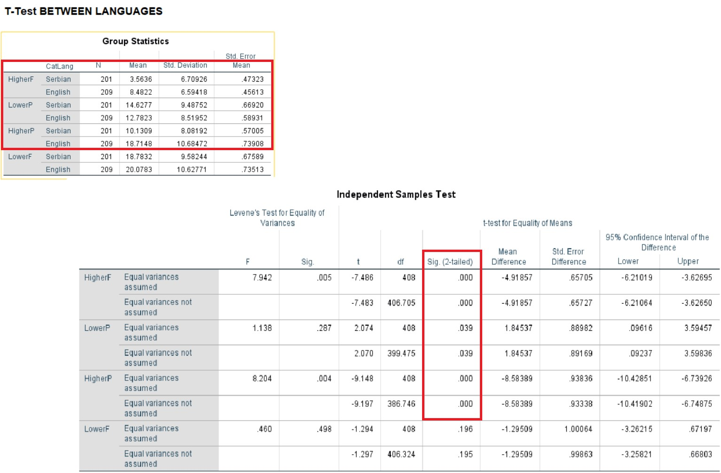
3. Research results
How do the Serbian and English sub-corpora compare when it comes to SCALARITY of IS? How do they employ their resources? More intense schematic manifestation vs the less intense.

Slide 25
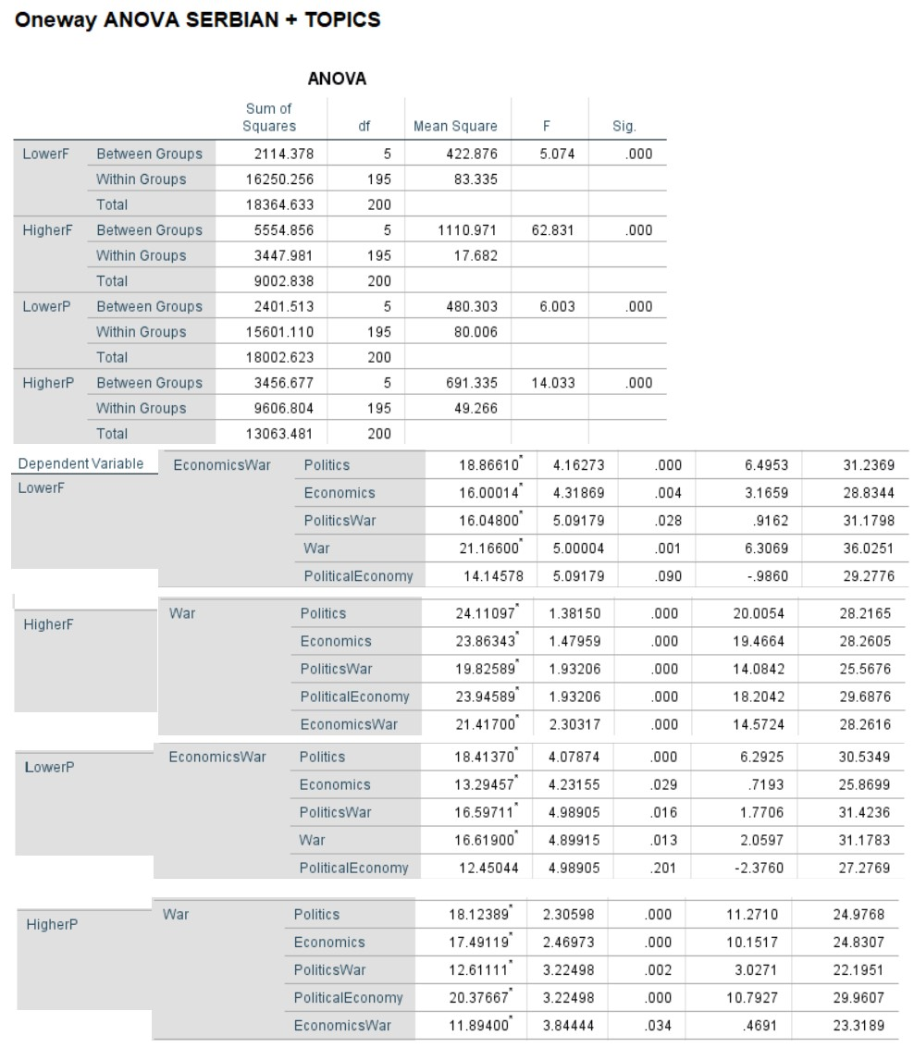
3. Research results
How do the Serbian and English sub-corpora compare when it comes to scalarity of IS in relation to the TOPIC? More intense schematic manifestation vs the less intense.

Slide 26
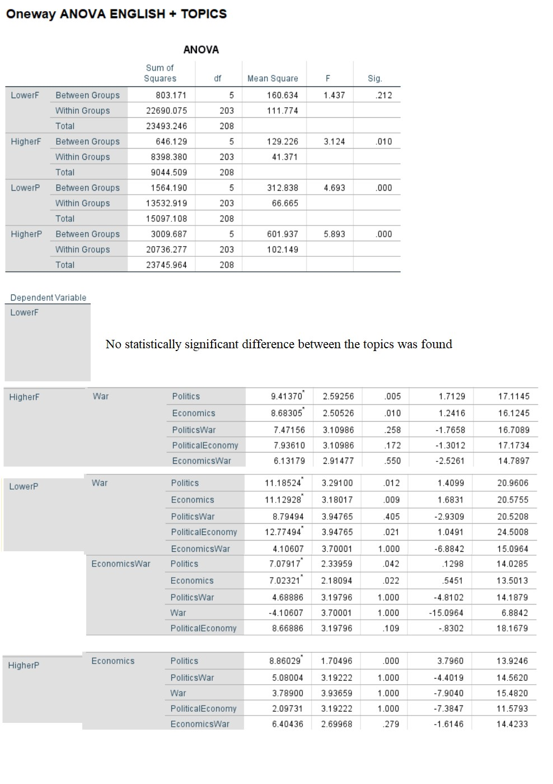
3. Research results
How do the Serbian and English corpora compare when it comes to scalarity of IS in relation to the TOPIC? More intense schematic manifestation vs the less intense.

Slide 27
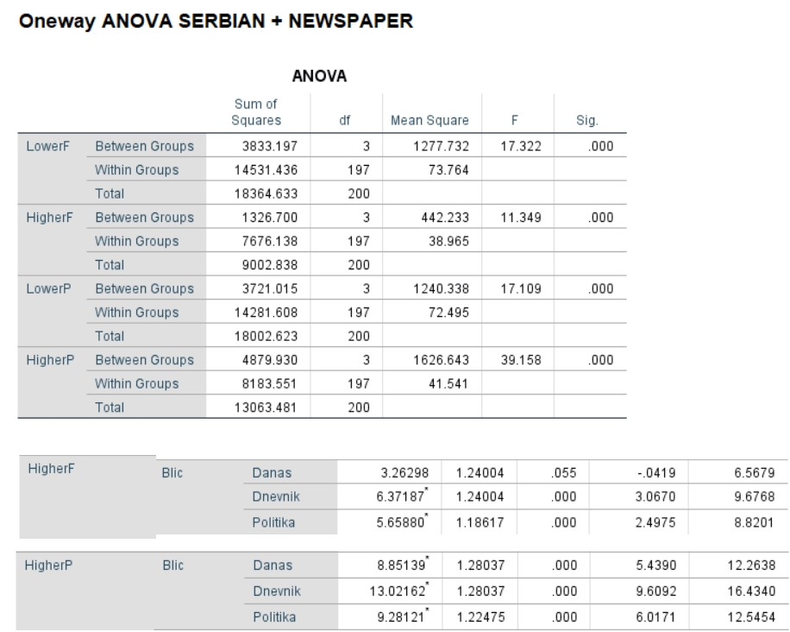
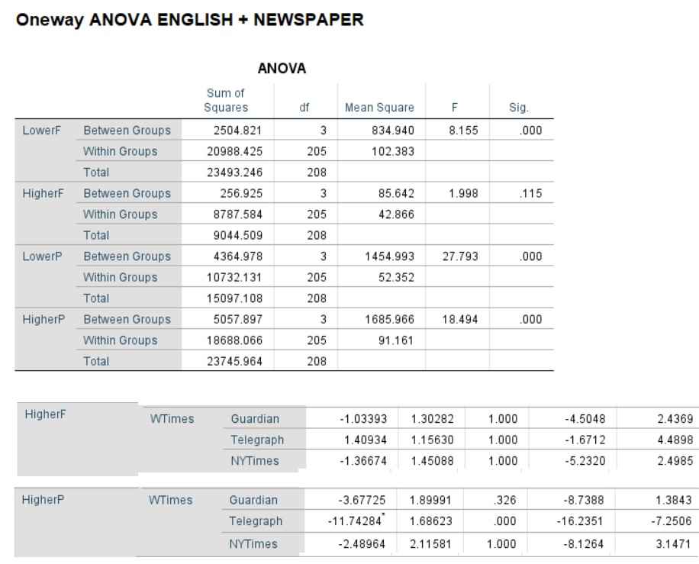
3. Research results
How do the Serbian and English corpora compare when it comes to scalarity of IS in relation to the MEDIA? More intense schematic manifestation vs the less intense.

Slide 28
4. Discussion
A significant difference in favor of unique metaphorical schema complexes and the total number of metaphorical schema complexes was observed.
Taken together these results imply that schematic complexes structure metaphorical (i.e. figurative language) more than they do literal language in the observed corpus.

Slide 29
4. Discussion
The obtained results suggest that there are no significant differences in the distribution of schematic complexes across the two compared languages i.e. on the level of comparable corpora both languages use approximately similar numbers of schematic resources (complexes).
Differences from this norm were observed when individual target languages were investigated.

Slide 30
4. Discussion
For example, in the Serbian sub-corpora the difference between unique complexes occurring in non-metaphorical and metaphorical contexts was statistically non-significant, suggesting that Serbian discourse employs a similar amount of unique schematic complexes to structure both literal and figurative language.
A similar dis-balance between the total number of schemas occurring in literal and figurative contexts was observed.
Taking into consideration the difference that exists between the two sub-corpora, these findings suggest that both languages use a similar strategy of distribution when it comes to schematic complexes – they are primarily embedded in metaphorical rather than non-metaphorical contexts.
The point of difference is found in the distribution of unique schemas, with Serbian using similar numbers of unique schematic complexes to structure both literal and figurative language when compared to English.

Slide 31
4. Discussion
The increase of the number of schemas in a complex DOES NOT NECESSARILY INCREASE the figurativeness of the expression, but
Their individual intensity can signal a CHANGE in the affective connotation of the targeted expression, based on discourse topic and type of media.

Slide 32
4. Discussion
The results
- the Serbian corpus: dominated by schemas marked for higher scalarity values for the schema P,
- the English corpus: dominated by “Higher F” scalar designations.
This may suggest greater insistence on finality, completeness and result in the argument or account of the Serbian text, whereas the English is suggestive of opting for more forceful and convincing expression, sometimes affected formulation and the power of language for argumentative purposes.

Slide 33
4. Discussion
The Serbian corpus showed sensibility in terms of “Lower F” in the domain of economy and war.
“Higher F” in the topic of war is dominant.
In English no statistically relevant “Lower F” instantiations.
“Higher F” statistically more relevant in the topic of war than in any other topic, politics, economy, etc.
Overall, English uses more forceful language than Serbian with the topic of war.

Slide 34
4. Discussion
The results - statistical sensibility to the factor of type of newspaper, as the Serbian corpus has shown the greatest level of affectiveness at the level of Blic, the only tabloid-like journal.
Blic used more “Higher F” and “Higher P” values than other Serbian media, except for Danas, the government-opposing daily, close to it.
The same could not be claimed for any English-language newspaper, independent or conservative, not even The Washington Times.
More reservedness in terms of affectiveness is registered with established and government-prone media, such as The New York Times and Politika.

Slide 35
5. Conclusion
In terms of conceptualizations - NO GREAT DIFFERENCES between English and Serbian speakers.
Number of schemas involved per conceptualization, non-metaphorical vs metaphorical expressions, etc.
A common conceptualizing mechanism.
A clear preponderance of metaphorical over non-metaphorical conceptualizations when motion is considered.

Slide 36
5. Conclusion
Some of the preliminary conclusions from the paper to appear in Pragmatics and Cognition have been validated.
The present approach allows for assessing the emotional involvement and the affectiveness by the participants in an act of communication.
The higher the usage of +valence schemas, the more affectively colored communication.

Slide 37
5. Conclusion
The topic that exhibited more affected conceptualizations is war but with a different rate in the English and Serbian media.
A clear indication of different attitudes toward the same topics, e.g. the war in Ukraine, economic issues, political integration, etc.

Slide 38
5. Conclusion
The present approach and methodology - applicable to measure the emotional load based on the conceptual building blocks and their scalarity, even with not so obvious cases of language use.
Empirically demonstrated
  how formal criteria can be applied to tackle aspects of meaning generation and
  how variation in terms of scalarity could be interpreted to reveal pragmatic effects.

Slide 39
References and literature
Antović, M., Jovanović, V. Ž. & Figar, V. (2023). Dynamic Schematic Complexes: Image Schema Interaction in Music and Language Cognition Reveals a Potential for Computational Affect Detection. Pragmatics and Cognition, (in press).
Antović, M. (2022). Multilevel Grounding: A Theory Of Musical Meaning. New York: Routledge.
Barrett, L. F. (2006). Solving the emotion paradox: Categorization and the experience of emotion. Personality and Social Psychology Review, 10(1), 20–46.
Cameron, L. (2007a). The affective discourse dynamics of metaphor clustering. Ilha do Destero Florianopolis, 53, 41–61.
Cameron, L. (2007b). Patterns of metaphor use in reconciliation talk. Discourse and Society, 18(2), 197–222.
Cameron, L. J. and J.H. Stelma (2004). Metaphor clusters in discourse. Journal of Applied Linguistics, 1(2), 107–136.
Cienki, A. (1997). Some properties and groupings of image schemas. In M. Verspoor, K. D. Lee, & E. Sweetser (Eds.). Lexical and Syntactical Constructions and the Construction of Meaning (pp. 3–15). Amsterdam: John Benjamins.
Clausner T. C. & Croft W. (1999). Domains and image schemas. Cognitive Linguistics, 10(1), 1–31.
Dewel, R. (2005). Dynamic patterns of CONTAINMENT. In Hampe, B. (Ed.). From Perception to Meaning. Image Schemas in Cognitive Linguistics (pp. 369–394). Berlin and New York: Mouton de Gruyter.
Duncan, S., & Barrett, L. F. (2007). Affect is a form of cognition: A neurobiological analysis. Cognition and Emotion, 21(6), 1184–1211.
Evans, V. & Green, M. (2006). Cognitive Linguistics: An Introduction. Edinburgh: Edinburgh University Press.
Grady, J. E. (2005). Image schemas and perception: Refining a definition. In Hampe, B. (Ed). From Perception to Meaning: Image Schemas in Cognitive Linguistics. Berlin: Walter de Gruyter, 35–55.
Hampe, B. (Ed.) (2005). From perception to meaning: Image schemas in cognitive linguistics. Berlin:Walter de Gruyter.
Hedblom, M., Kutz, O., & Neuhaus, F. (2015). Choosing the right path: Image schema theory as a foundation for concept invention. Journal of Artificial General Intelligence, 6(1), 21–54.
Hedblom, M. M., Kutz, O., & Neuhaus, F. (2016). Image schemas in computational conceptual blending. Cognitive Systems Research, 39, 42-57.
Hedblom, M., Kutz, O., Peñaloza, R., & Guizzardi, G. (2019). Image Schema Combinations and Complex Events. Künstliche Intelligenz, 33, 279–291.
Johnson, M. (1987). The body in the mind. The bodily basis of meaning, imagination, and reasoning. Chicago: The University of Chicago Press.

Slide 40
References and literature
Johnson, M. (2005). The philosophical significance of image schemas. In Hampe, B. (Eds). From Perception to Meaning: Image Schemas in Cognitive Linguistics (pp. 15–33). Berlin: Walter de Gruyter.
Johnson, M. (2007). The meaning of the body. Aesthetics of human understanding. Chicago: The University of Chicago Press.
Krzeszowski, T. P. (1993). The axiological parameter in preconceptual image schemata. In Geiger, R., & Rudzka-Ostyn, B. (Eds.). Conceptualizations and Mental Processing in Language (pp. 307–330), Berlin & New York: Mouton de Gruyter.
Lakoff, G. (1987). Women, fire, and dangerous things: What categories reveal about the mind. Chicago: The University of Chicago P.
Lakoff, G., & Johnson, M. (1980). Metaphors we live by. Chicago: The University of Chicago Press.
Lakoff, G., & Johnson, M. (1999). Philosophy in the flesh: The embodied mind and its challenge to Western thought. New York: Basic Books.
Lakoff, G., & Turner, M. (1989). More than cool reason: A field guide to poetic metaphor. Chicago: The University of Chicago Press.
Lakoff, G. (1990). The invariance hypothesis: Is abstract reason based on image schemas? Cognitive Linguistics, 1(1), 39–74.
Mandler, J. & Cánovas, C. P. (2014). On defining image schemas. Language and Cognition, 6(4), 1–23.
Mandler, J. (1992). How to build a baby: II. Conceptual primitives. Psychological Review, 99(4), 587–604.
Mandler, J. (2004). The foundations of mind: Origins of conceptual thought. New York: Oxford University Press.
Mandler, J. (2005). How to build a baby: III. Image schemas and the transition to verbal thought. In Hampe, B. (Ed.) From Perception to Meaning: Image Schemas in Cognitive Linguistics (pp. 137–163). Berlin: Walter de Gruyter.
Mandler, J. (2012). On the spatial foundations of the conceptual system and its enrichment. Cognitive Science, 36(3), 421–451.
Oakley, T. (2007). Image schema. In Geeraerts, D., & Cuyckens, H., (Eds.). The Oxford Handbook of Cognitive Linguistics (pp. 214–235). Oxford: Oxford University Press.
Popova, Y. (2005). Image schemas and verbal synaesthesia. In Hampe, B. (Ed.). From Perception to Meaning: Image Schemas in Cognitive Linguistics (pp. 395–419). Berlin: Walter de Gruyter.
Russel, J. A. (1980). A circumplex model of affect. Journal of Personality and Social Psychology, 39(6), 1161–1178.
Russel, J., A., Weiss, A., Mendelsohn, G., A. (1989). Affect grid: A single-item scale of pleasure and arousal. Journal of Personality and Social Psychology, 57(3), 493–502.
Russel, J., A. (2003). Core affect and the psychological construction of emotion. Psychological Review, 110(1), 145–172.
Saslaw, J. (1996). Forces, containers, and paths: The role of body-derived image schemas in the conceptualization of music. Journal of Music Theory, 40(2), 217–243.
Stadler, M. W. (2020). The ontological nature of part-whole oscillations. Vienna: Austrian Academy of Sciences Press.

Slide 41
Thank you for your attention!
vladimirz.jovanovic@filfak.ni.ac.rs
biljana.misic.ilic@filfak.ni.ac.rs
marta.velickovic@filfak.ni.ac.rs

